Slide 1


E-Voting Implementation in India Using Blockchain Application

Slide 2

CONTENTS
1. Introduction
2. Literature Review
3. Problem Statement
4. Proposed Solution
5. Objectives
6. References

Slide 3



Slide 4


Why E-Voting on blockchain ?

Slide 5






1. Introduction
1
Voting is a very crucial activity for any institution or organization that needs to elect a certain entity for a certain role. Historically, the most common way to vote, still largely used nowadays, is through a paper-based system. Of course, this is not the safest nor the most convenient or economical method to support the voting process. a
The manual and EVM-based processes lack end-to-end transparency and accessibility, especially for remote voters.
2
4
Each vote can be recorded as a transaction on an immutable blockchain ledger, ensuring integrity and traceability.
3
Blockchain technology can revolutionize e-voting by introducing a secure, decentralized, and transparent digital platform.
5
A blockchain-based e-voting application could enable remote, verifiable, and tamper-proof voting while preserving voter anonymity.

Slide 6




2. Literature Review
Existing Systems
Related Research & Case Studies
Identified Gaps
• Current EVM and paper-based systems rely on physical verification and centralized storage and there is no such guarantee as of now for transparent voting.
• Lack of large-scale implementation for a diverse population.
• Blockchain Based E-voting System: A Proposal Completed Research(2019) by Jorge Lope, José Luís Pereira and João Varajão
• Need for Aadhaar-based authentication integration.
• The huge amount of money spent on elections.
• Online voting in small-scale contexts (e.g., societies, universities) lacks strong encryption or authentication.
• Scalability and cost optimization in public blockchain networks.
•No possible ways to implement this in India as of now due to the poor network infrastructure limiting the implementation of blockchain
• On the Design and Implementation of a Blockchain Enabled E-Voting Application Within IoT-Oriented Smart Cities GEETANJALI RATHEE OMER WAQAR 1,RAZI IQBAL 2,(Senior Member, IEEE), 3,(Member, IEEE), AND ALI KASHIF BASHIR 4,(Senior Member, IEEE)(2021)

Slide 7
3. Problem Statement
The Indian voting system lacks a secure, transparent, and remote-accessible digital mechanism. This project aims to research for a potential solution for a blockchain-based e-voting application ensuring transparency, anonymity, and trust in elections.

Slide 8
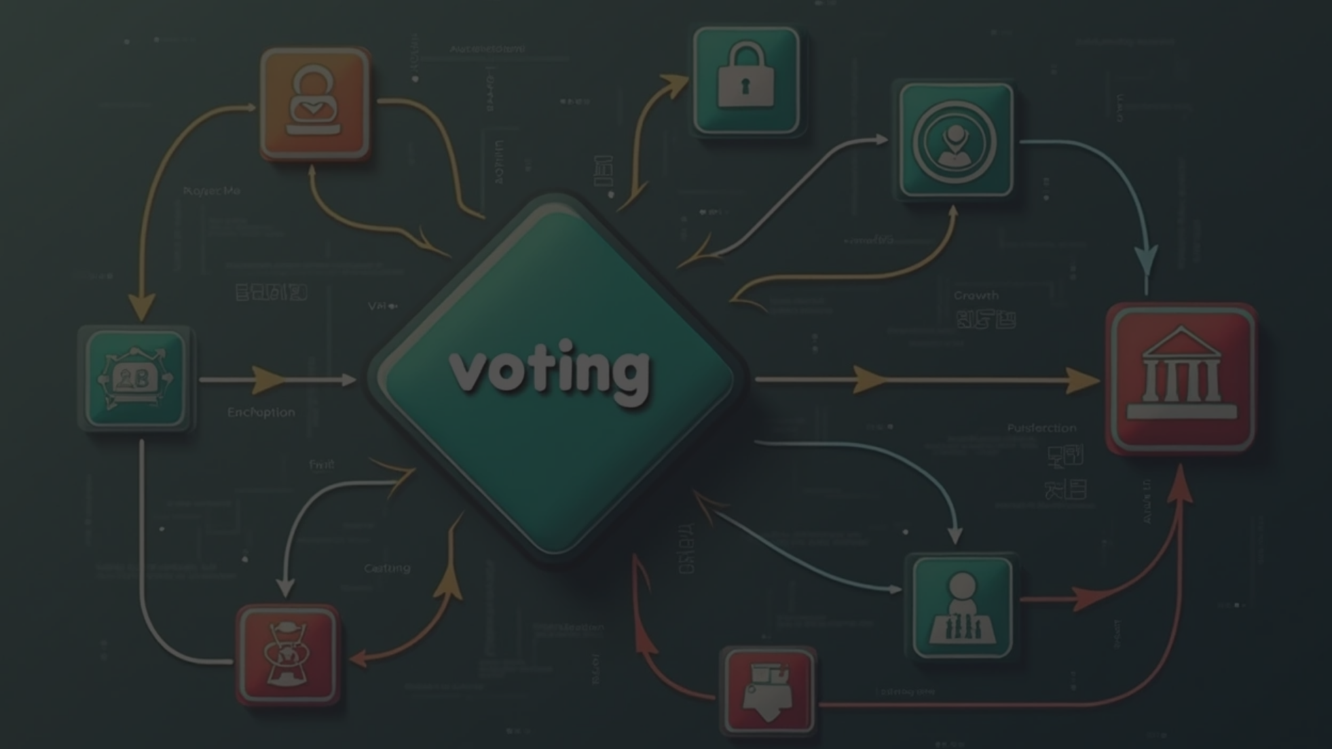


4. BENEFITS OF USING BLOCKCHAIN TECHNOLOGY
Proposed Blockchain-Based E-Voting Application:
Anonymity:
since every user is identified by a public key and the stored vote is encrypted, it is impossible to associate a voter with a vote;
Integrity:
since the hash pointer provides the blockchain with tamper-evident properties, every stored vote has the same properties, meaning that it can’t be adulterated;
Singularity:
Every vote cast is linked to the public key of the voter on the blockchain. By allowing each public key to cast only one vote, the singularity requirement is assured;
Authenticity:
Every user of the network is identified by a public key, which can only be accessed by its own private key. Assuming that every voter will keep its own private key secret, then the authenticity requirement is fulfilled;
.
Uncoercability:
Every vote cast will be encrypted before being stored on the blockchain, making it impossible for anyone to know the content of that vote;
Verifiability:
since the blockchain is transparent to every node of the network, everyone could confirm that the number of votes casted and counted are the same;

Slide 9
4. BENEFITS OF USING BLOCKCHAIN TECHNOLOGY
Proposed Blockchain-Based E-Voting Application:
Auditability and Certifiability:
equally to the verifiability requirement, the transparence property of blockchain allow
for any node in the network to audit the blockchain. Since the system code is open source and visible on the blockchain, means that the used application could be also audited;
Mobility:
the only requirements to access the network is a device with internet connection and an address in the blockchain platform, meaning that it is not required any kind of special infrastructure or voting machines;.
Transparency:
identically to the Auditability and Certifiability requirement, transparency is one of the blockchain properties, and every application implemented in the blockchain inherits this same property;.
Availability:
since blockchain is a distributed network, as long as the network has the required number of nodes to achieve consensus, the voting system will be always available;
Accessibility and Convenience:
equal to the mobility requirement, blockchain does not require any kind of infrastructure or voting machines. Only a device with an internet connection is required;
Detectability and Recoverability:
If any malicious action is made on the blockchain, it will be detected by the system and considered invalid, which fulfils the detectability requirement. In the case of recoverability, as soon as some data is stored on the blockchain, no longer can be deleted, meaning that data can always be recovered.

Slide 10








5. Objectives
1
2
3
To develop a blockchain-based e-voting web or mobile application.
To ensure transparency and tamper resistance in the voting process.
To provide secure voter authentication using Aadhaar-linked identity.
4
5
To enable remote participation for voters across India.
To build a scalable and cost-efficient blockchain voting model.

Slide 11

Thank You

